Slide 1
When you think about what makes a community strong or successful, what comes to mind?

Slide 2
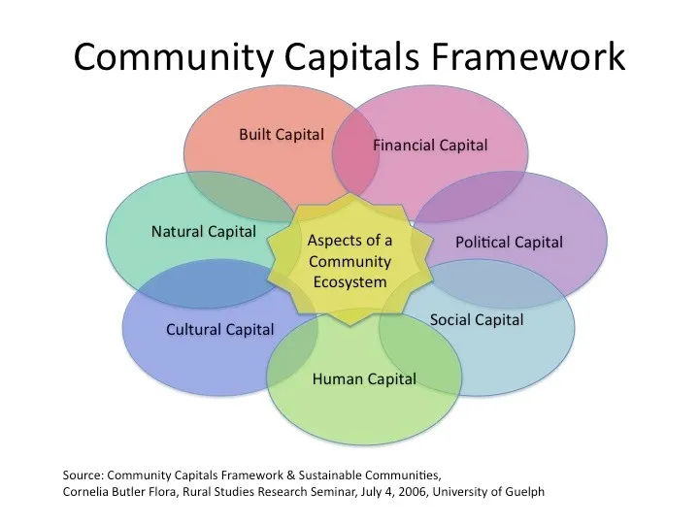
We’ll follow along with Part 1 of your worksheet!
Notes:
So when we think about problems and solutions, we need to look at what resources are being strained and what resources aren’t being addressed.

Slide 3
In a group of 2-3, choose one local institution, resource, or problem

Slide 4
Natural Capital
Environment, land, water, air, and natural resources
Ex. Fast Fashion: Cotton fields, water for dyeing and washing textiles, synthetic materials derived from petroleum, farmland used for textile crops
What are some natural capitals that exist in your group’s example?

Slide 5
Cultural Capital
Values, traditions, heritage, ways of knowing
Ex. Fast Fashion: Global trends; influencer culture and fashion cycles; aesthetic values tied to social status and identity; traditions of dress and beauty standards.
What are some cultural capitals that exist in your group’s example?

Slide 6
Human Capital
Education, skills, health, leadership, creativity
Ex. Fast Fashion: Laborers’ skills in sewing and garment assembly; designers’ creativity and technical knowledge; marketing
What are some human capitals that exist in your group’s example?

Slide 7
Social Capital
Access to power, voice in decision-making, influence
Ex. Fast Fashion: Networks between suppliers, manufacturers, and retailers; relationships between fashion influencers and followers; community groups that share, swap, or donate clothes; trust among brand consumers
What are some social capitals that exist in your group’s example?

Slide 8
Political Capital
Access to power, voice in decision-making, influence
Ex. Fast Fashion: Trade policies regulating imports and exports; labor laws; environmental regulations
What are some political capitals that exist in your group’s example?

Slide 9
Financial Capital
Money, investments, credit, infrastructure funding
Ex. Fast Fashion: Corporate profits; investor funding for major brands; consumer spending on clothing; global economic systems that keep prices low
What are some financial capitals that exist in your group’s example?

Slide 10
Built Capital
Physical infrastructure (roads, buildings, technology, housing)
Ex. Fast Fashion: Factories, warehouses, ports, and shipping infrastructure; retail stores; machinery for production; digital infrastructure that enables global e-commerce
What are some natural capitals that exist in your group’s example?

Slide 11
Where does your research come into play?
Let’s see CCF in action!

Slide 12
In groups of 2-3
Open the file in the Week 7 Module called “EmeryFloraSpiralingUp2006”
Give each group member a role:
Cartographer
Evaluator
Connector
Practice your skimming skills and take 10 minutes to read the article.
Discuss your roles (on the next slide)

Slide 13
🗺️ The Cartographer
Your Goal: Identify and describe the seven community capitals and how they interact in the case study.
While You Read:
Highlight where each capital is defined (natural, cultural, human, social, political, financial, built).
Note examples from Valley County that show these capitals working together.
After Reading:
Which capital seems most central to the authors’ story?
How does social capital serve as a starting point for change?
🧭 The Evaluator
Your Goal: Examine how the authors support their claims about community transformation.
While You Read:
Underline phrases that describe evidence.
Identify the main argument. What are they claiming about “spiraling up”?
After Reading:
How do they use the CCF to explain why change happened, not just that it did?
What makes their argument credible or convincing?
🌍 The Connector
Your Goal: Connect the ideas in the article to a contemporary issue or your own research topic.
While You Read:
Highlight examples that remind you of other community challenges.
Think about “spiraling up” and “spiraling down”. Where do you see those patterns today?
After Reading:
Which capitals seem most relevant to your research topic?
How might you use the CCF to analyze the systems or relationships shaping your issue?

Slide 14
In your research project, consider how you can use capitals to talk about spiraling up or spiraling down
Part 2 of your Worksheet!

Slide 15
Writing Check-in
By now you should know:
Your topic
A few useful sources
Language to talk about problems and solutions
Which means you can start:
Reading sources in-depth
Taking notes on similarities and differences between sources
Contacting your local sources for observations/interviews

